Slide 1
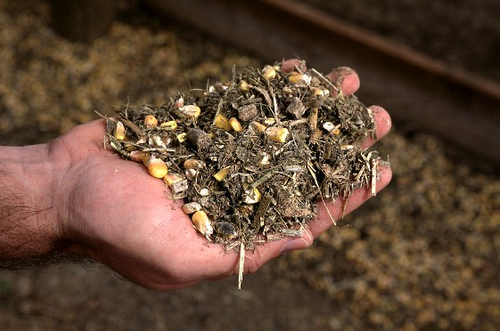
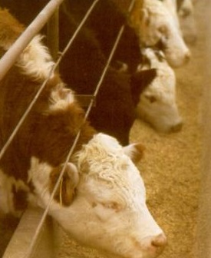
Nutrition and Feeding
For
Show Animals
Dr. Matt Hersom
Dept. of Animal Sciences
University of Florida

Slide 2
Questions for You
What is the most important nutrient?
What nutrient drives body weight gain?
How much should your animal eat?
Which minerals help bone formation?
What is the most limiting amino acid for pigs?
How do you calculate average daily gain?
What is the best feed?

Slide 3
GAME PLAN
Purchase date & show date = time on feed
Purchase weight & show weight = total gain Frame size/growth potential – show weight
Gain – lbs/day
Calves – 3.0 to 4.5 lb/day
Hogs – 0.5 to 3.5 lb/day
Lambs – 0.5 to 1.25 lb/day
Goats – 0.25 to 1.0 lb/day
Feed requirement – light, moderate, heavy

Slide 4
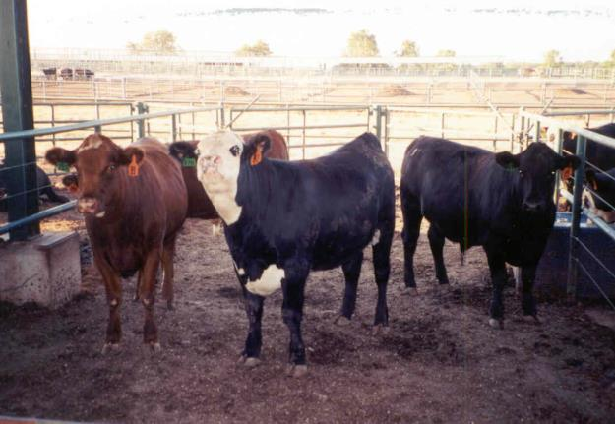
Important Terms
Starter/Grower
Mission is to grow in size and lean muscle
Finisher
Mission is to finish growing: muscle and fat

Slide 5
Nutrition Terminology
Abbrev. | Name | Units | Definition
DMI | Dry Matter Intake | lbs, kg | Feed consumption on a dry weight (no water) basis
CP | Crude Protein | % | Measure of protein content of a feed
TDN | Total Digestible Nutrients | % | Routine measure of energy content of a feed, applicable for cattle, sheep, goats, horses
ME | Metabolize Energy | Mcal/lb | More refined measure of energy content of a feed
Ca | Calcium | % | Mineral
P | Phosphorus | % | Mineral
Crude Fiber, ADF, NDF, | Acid or Neutral Detergent Fiber | % | Fiber is a component of any plant product, some is digestible and provides energy, other fiber is not digestible
Crude Fat |  | % | Measure of fat in a feedstuff

Slide 6
Important Terms
Dry Matter (DM)
Feeds vary in water content
Fresh pasture can be 70% water
Corn or other grains are about 10% water
By accounting for water content, feeds can be accurately evaluated for the other nutrients!

Slide 7
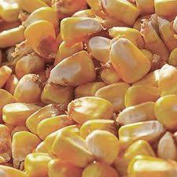
Important Terms
TDN (Total Digestible Nutrients, %)
A good way to estimate energy density of a feed
Growing beef require between 65-75% TDN
Ask your feed dealer for this value (not on feed tag)
TDN ≈ 80% - Crude Fiber %
Metabolizable Energy (mcal)
More precise way to evaluate energy density of feed, swine and beef cattle
How much energy is available for the animal to use

Slide 8
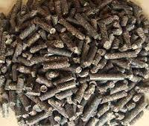
Important Terms
CP (crude protein)
Estimates how much protein in a feed, but doesn’t tell how much can actually be used by the animal
Amounts different between species and stage of growth
Info on feed tag
Amino Acids
Specific ones are supplemented for
monogastrics

Slide 9
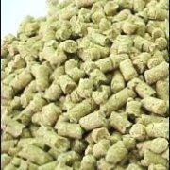
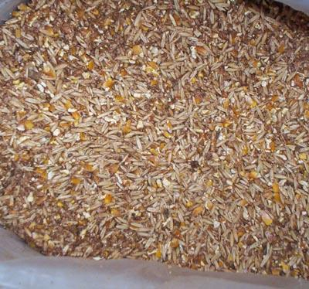
Important Terms
Supplement
Used in addition to locally available forages and grains (“supplements” other feeds)
Complete Feed
Designed to be the only feed fed, includes all nutrients an animal needs (roughage included)

Slide 10
What do feeds provide?
What is a nutrient?
Chemical substance that provides nourishment for the body
What types of nutrients are there?

Slide 11
What types of nutrients are there?
Vitamins
= Energy
Protein
Minerals
Carbohydrates
Fats
WATER

Slide 12
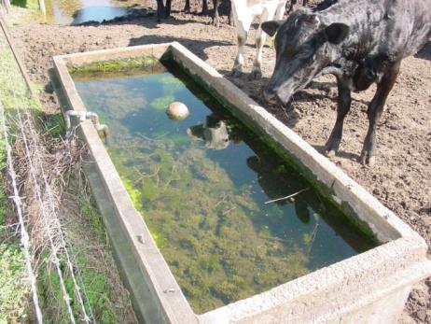
Types of Nutrients…
Water – the MOST IMPORTANT
Animal’s body is 70% water
Water consumption drives feed intake
Thirsty animals don’t eat
Important for nutrient transport, waste removal, and digestion
Supply CLEAN, FRESH, cool SUPPLY daily!!!
If you won’t drink it why should they

Slide 13
Consumption of Water
Most important nutrient
Dependent upon environmental conditions
For the unstressed animal
Swine 1.5 - 3.0 gallons /day
Sheep/Goats 1.5 - 3.0 gallons /day
Cattle 10 - 14 gal/d~ 1 gal/100 lbs BW
Horses 10 – 14 gal/day~ 1 gal/100 lbs BW

Slide 14
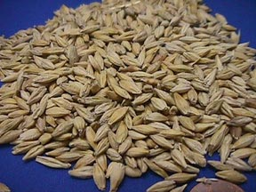
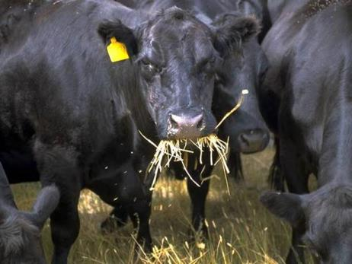
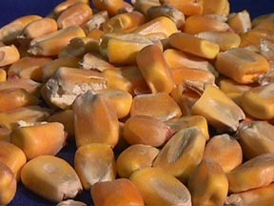
Types of Nutrients…
Carbohydrates
Provide ENERGY!!
Energy needed to grow and perform
Examples include grain, hays
Makes up over 80% of growing animal ration

Slide 15
Energy
Total Digestible Nutrients (TDN) or Metabolizable Energy (ME)
Major “nutrient” required by animal for growth
Product of digestion of feed, pasture most important source
Direct relationship between TDN and quality of feedstuff
Low quality feed = low energy and low intake
Feed | % TDN
Bahiagrass Hay | 51
Alfalfa Pellet | 59
Corn | 88
Soybean Meal | 84
Molasses | 72
Where do they get it
Pasture/grass
Hay
Pellet / Cube
Manufactured feed
Liquid feed
NOT from mineral supplement
What provides energy to animals
Carbohydrates
Fats/Lipid
Some protein

Slide 16
Types of Nutrients…
Protein
Needed for growth and development
Immunity
Easy to find on feed tag
Where do they get it
Pasture/grass
Hay
Pellet / Cube
Manufactured feed
Liquid feed
Rumen bacteria
(Urea)
NOT from mineral supplement

Slide 17
Protein
Feed | % CP
Bahiagrass Hay | 8
Alfalfa Pellet | 17
Corn | 9
Soybean Meal | 53
Molasses | 5
Urea | 291
Crude Protein (CP)
Natural: soybean and/or cottonseed meal, alfalfa, CGF
Animal performance: natural>NPN
Supply protein, energy, and other nutrients
Often fed in dry or pellet feeds
Increased cost/lb but valuable source of protein
NPN: urea – ruminants only
Works best with medium- and high-energy diets
Lacks energy, vitamins, and minerals
Management and toxicity issues
Dry or liquid feeds
Amino Acids
monogastrics

Slide 18
Lipids
Where do they get it
Pasture/grass
Hay
Pellet / Cube
Manufactured feed
Liquid feed
Formulated blocks
Fat provides energy
Fat is not the most important nutrient in the diet
Fat is not main driver for energy

Slide 19
Vitamins
Where do they get it
Pasture/grass
Hay
Pellet / Cube
Manufactured feed
Liquid feed
Loose mineral
Formulated blocks
NOT from trace mineral SALT block
Salt + color
Fat Soluble
Vitamin A, D, E
Need to be supplemented
Water Soluble
B-vitamins, C, K
Ruminants make these
Hogs need them supplemented

Slide 20
Minerals
Where do they get it
Pasture/grass
Hay
Pellet / Cube
Manufactured feed
Liquid feed
Loose mineral
Formulated blocks
NOT from trace mineral SALT block
Salt + color
Macro Minerals
Ca, P, Mg, Na, Cl, K, S
Occur in large amounts (%)
Micro Minerals
Co, Cu, F, Fe, I, Mn, Mo, Se, Zn
Occur in small amounts (ppm)
Cu above 11 ppm toxic to sheep

Slide 21
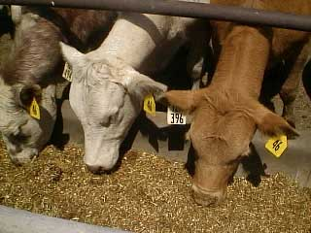
Nutrient Requirements
Your animal requires minimum amounts of the various nutrients
This amount varies based upon
Age, weight, breed, exercise/stress level, balance of the other nutrients, etc
Important to know how your animal’s requirements change over the feeding period

Slide 22
Hierarchy of Nutrient Use
Maintenance
Survival - bodily functions, digestion, locomotion
Growth (young animals)
Muscle, fat, and bone growth
Lactation
Milk production for offspring – energy/protein intensive
Reproduction

Slide 23
Growth Curve
4
3
2
market
1. Prenatal
1
2. Rapid Growth
Wt.
3. Fat deposit begins
4. Fat
Time

Slide 24
Growing Animal Intake Requirements
Intake
Energy
Intake Requirements
Protein

Slide 25
Growing Animal Mineral Requirements
Calcium
Intake Requirements
Phosphorus
Units are % of Diet

Slide 26
Growing Animal Requirements Summary
As BODY WEIGHT INCREASES…
Dry Matter Intake INCREASES
Energy Needs INCREASE
Protein Needs DECREASE
Calcium and Phosphorus Needs DECREASE

Slide 27
Nutrient Ranges
 | Intake | Energy | Protein | Fat | Fiber
Fowl | 50 – 1600 g/week | 6200 – 7300 kcal/lb ME | 12 – 26% CP | -- | --
Cow | 1.5 – 3.0% BW | 45 – 90% TDN | 6 – 18% CP | < 4% total diet | > 8% NDF in diet
Goat | 1.3 – 4.2% BW | 53 – 68% TDN | 5.5 – 20% CP | < 4% total diet | > 8% NDF in diet
Horse | 1.5 – 3.0% BW | 0.9 – 1.40 mcal/lb DE | 8 – 14.5% CP
Pig | 3 lbs to 5% BW | 7200 kcal/lb ME | 12 – 26% CP | 3.5-6.5% | --
Sheep | 1.5 – 5.2 % BW | 55 – 80% TDN | 9 – 26% CP | < 4% total diet | > 8% NDF in diet

Slide 28
Appropriate Feeds Animals
 | Pasture | Hay | Corn / Grain | Pellet/ Cube | Meal/Mash | Browse | Sweet Feed | Liquid Supp | Loose Mineral | Salt-Mineral Block
Fowl | (X) |  | X | X | X |  |  |  |  | no
Cow | X | X | X | X |  |  |  | X | X | no
Goat | X | X | X | X |  | X |  |  | X | no
Horse | X | X | X | X |  |  | X |  | X | no
Pig | ( X ) |  | X | X | X |  |  |  | (X) | no
Sheep | X | X | X | X |  | X |  |  | X | no

Slide 29
Simple Feed Classifications
Roughage | Grains | Protein Meals | By-Products | Additives | “Bad” Stuff
Hay Alfalfa cubes Beet pulp Cottonseed hulls Silage | Corn Oats Barely Wheat Milo / Sorghum | Soybean meal Cottonseed meal Corn gluten feed Fish meal | Citrus pulp Corn gluten feed Dried distillers grains Molasses Wheat midds Rice mill feed | Trace minerals Vitamins Flavors Probiotics Antibiotics Urea Ionophores | Peanut skins Peanut hulls Grain screenings

Slide 30
Feed Tag Review
Guaranteed Analysis: CP, Fat, Fiber, Min/Vit TDN??
Ingredient List
Feeding Directions
Caution Statements
TDN = 80% - Crude Fiber
TDN = 78%, different than rough calc
of 80%-7%, why?

Slide 31
Table 4. Estimating TDN of commercial feed (base: 13% crude protein, 2% crude fat) using fiber and ash content¹
 | % Ash on the feed tag
% Crude Fiber on feed tag | 2 | 4 | 6 | 8 | 10 | 12
2 | 86.9 | 85.1 | 82.3 | 81.5 | 79.7 | 77.9
3 | 86.1 | 84.3 | 82.5 | 80.7 | 78.9 | 77.1
4 | 85.3 | 83.5 | 81.7 | 79.9 | 78.1 | 76.3
5 | 84.5 | 82.7 | 80.9 | 79.1 | 77.3 | 75.5
6 | 83..7 | 81.9 | 80.1 | 78.3 | 76.5 | 74.7
7 | 82.9 | 81.1 | 79.3 | 77.5 | 75.7 | 73.9
8 | 82.1 | 80.3 | 78.5 | 76.7 | 74.9 | 73.1
9 | 81.3 | 79.5 | 77.7 | 75.9 | 74.1 | 72.3
10 | 80.5 | 78.7 | 76.9 | 75.1 | 73.3 | 71.5
¹ For 16% protein feed, deduct 0.5% TDN from the estimate in the table For 10% protein feed, add 0.5% TDN to the estimate in the table For each 1% fat over 2% add 2.25% TDN to the estimate in the table Adapted from J. Sprinkle, 1999, Univ. of Arizona Coop. Extension bulletin AZ1054

Slide 32
Feed Tag Review
Guaranteed Analysis: CP, Fat, Fiber, Min/Vit TDN??
Ingredient List
Feeding Directions
Caution Statements
TDN = ??

Slide 33
Feed Tag Review
Guaranteed Analysis: CP, Fat, Fiber, Min/Vit TDN??
Ingredient List
Feeding Directions
Caution Statements
TDN = 71%, let’s examine
the ingredients

Slide 34
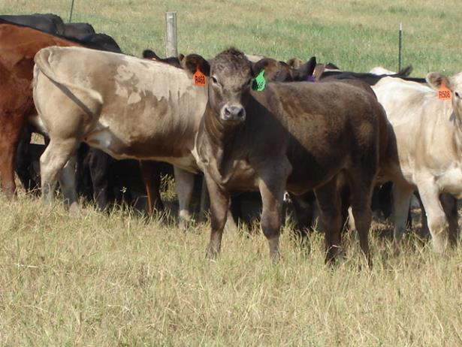
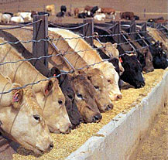
Management and Feeding
Water
Bunk Space
Feed Delivery
Amount
Self vs hand fed
Frequency and timing
Weigh
Exercise

Slide 35
Management and Feeding
The feeding program will dictate how your animals will develop and mature
A good feeding program cannot make up for a lack of superior genetics, but it will allow your animal to reach their genetic potential
A poor feeding program can cause an animal with great genetic potential to be wasted.

Slide 36
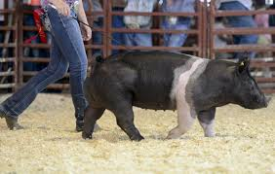
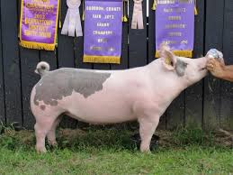
Show Pig Nutrition

Slide 37
Key Nutrients
Protein
18-22% crude protein, decline with increasing BW
Essential Amino Acids
Lysine is 1st limiting for growth
Threonine, Tryptophan, Methionine
Minimum Protein and Lysine Levels
 | Early Wean | Starter | Grower | Finish
Weight, lb | 11-25 | 25-100 | 100-200 | 200-240+
Protein, % | 22 | 21 | 20 | 18
Lysine, % | 1.25 | 1.15 | 0.95 | 0.75

Slide 38
Key Nutrients
Energy
75-80% diet should be carbohydrates
Fat is important source of energy
Fat is 2.25 times as energy dense as carbohydrates, a little goes a long ways
Fat Levels in Diet
 | Early Wean | Starter | Grower | Finish
Weight, lb | 11-25 | 25-100 | 100-200 | 200-240+
Fat, % | 6.5 | 5.5 | 5.0-4.5 | 3.5

Slide 39
Key Nutrients
Minerals
Macro
Ca
Fe
K
Mg
Na, Cl
P
Micro
Co
Cu
I
Mn
Se
Zn
Vitamins
Fat soluble
A, D, E, K
Water soluble
B12, Biotin, Folic Acid (B9), Riboflavin, Pantothenic Acid, Choline, Niacin, Pyridoxine (B6), Thiamin
Manufactured Feeds/ Mineral/Vitamin Supplement best bet to provide

Slide 40
Rations
Starter
Grower
25-100 lbs
Don’t limit feed intake
20-18% crude protein
5.5 % fat
1.2-1.3% Lysine
Encourage eating
50-150 lbs
Don’t limit feed intake
5% of BW intake
18-19% crude protein
4-5% fat
1.2-1.3% Lysine
Light exercise
Health and deworming

Slide 41
Rations
150 lbs to Show
Holding
150 to 200 lbs
3-5% of BW intake
Start weighing consistently
Manipulate diet to achieve goals
0.9-1.0% Lysine
Allow for growth during last 30 days
Need to gain more weight
Frequent small meals
Pelleted feed – intake and digestibility
Paylean
150 to 200 lbs
Always allow consumption of water
Use special rations or create your own
Allow some gain
Add bulk to diet for satiety, decrease total energy
Limit feed 2.5-3% BW
Minimum 4 lbs of feed

Slide 42
Management Stuff
Water delivery needs to be the same at home and show, performance is only as good as water intake
Exercise at start 1 to 2 times per week for 10-15 min (start just like we do)
Feed consistently- same time 2-3X/day
Weigh your pig-scale or cloth tape, calculate ADG
Paylean – follow directions, understand what it does, over 150 lb BW, last 45-90 lbs of growth

Slide 43
Estimating Pig Body Weight Without Scales
Inches of Clothing Tap | Pig Weight, lbs
25 | 49
26 | 59
27 | 69
28 | 79
29 | 89
30 | 99
31 | 110
32 | 120
33 | 130
34 | 140
35 | 150
36 | 160
Inches of Clothing Tap | Pig Weight, lbs
37 | 171
38 | 181
39 | 191
40 | 201
41 | 211
42 | 221
43 | 232
44 | 242
45 | 252
46 | 262
47 | 272
48 | 282
Measure the distance from the top of the shoulders down and around the chest of the pig just behind the front legs
and back up to the starting point. The pigs should be on continuous feed and water to insure accuracy of results.
From K-State Show Pig Guide, J. DeRouchey. http://fyi.uwex.edu/fdlmeat/files/2009/09/K-State-Show-Pig-Guide.pdf

Slide 44
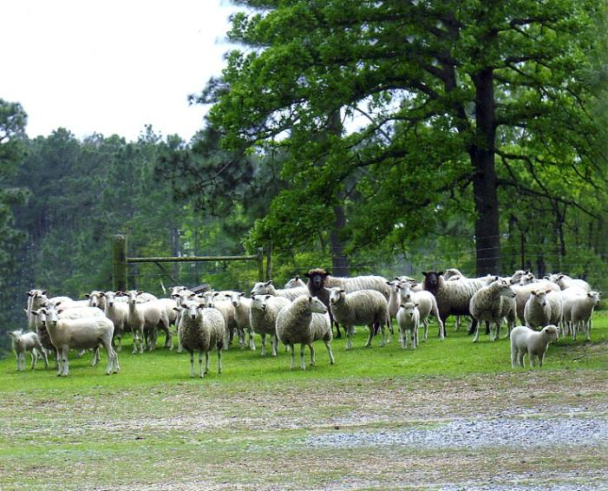
Sheep and Goat Nutrition

Slide 45
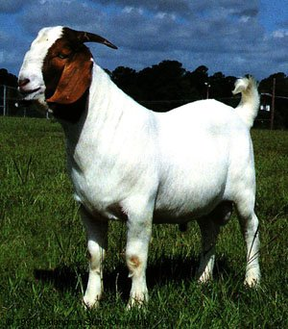
Growth Requirements
In goats energy and protein
are linked together
ADG, lb/d | Add. Intake, lb | TDN, lb | CP, lb
0.22 | 0.33 | 0.44 | 0.03
0.44 | 0.66 | 0.88 | 0.06
0.66 | 1.00 | 1.32 | 0.09

Slide 46
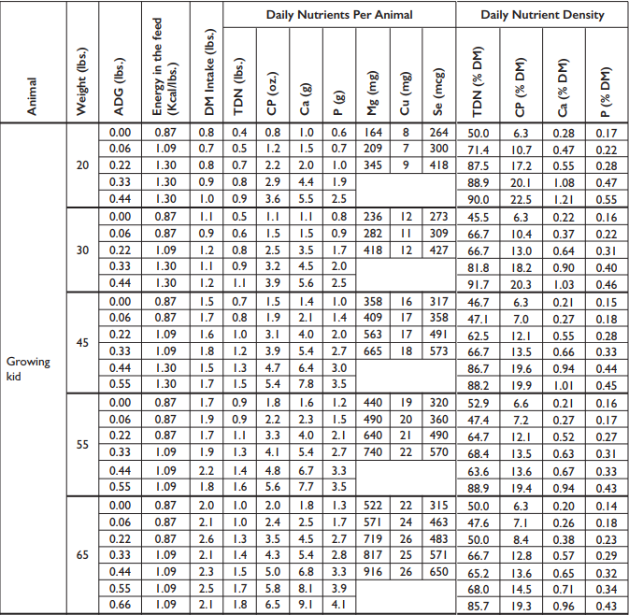
Nutrient Requirements of Goats

Slide 47
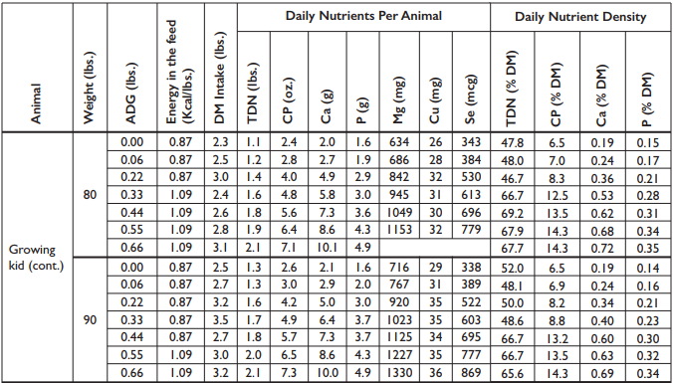
Nutrient Requirements of Goats

Slide 48
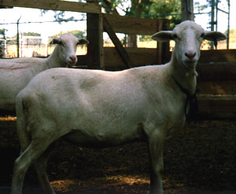
Growing Lambs and Feed Intake
The lower the body weight and younger age of the lamb the greater the intake
Sex of the lamb influences intake
 | BW | Intake, % of BW
Replacement Ewe / Ram Lamb | 66 | 4.0 / 4.5
 | 88 | 3.5 / 4.0
 | >110 | 2.5 / 3.5
Market Lamb, 4-7 month | 66 | 4.3
 | 88 | 4.0
 | >110 | 3.2

Slide 49
Effect of Growing Lamb BW on Energy Requirement

Slide 50
Effect of Growing Lamb BW on Protein Requirement

Slide 51
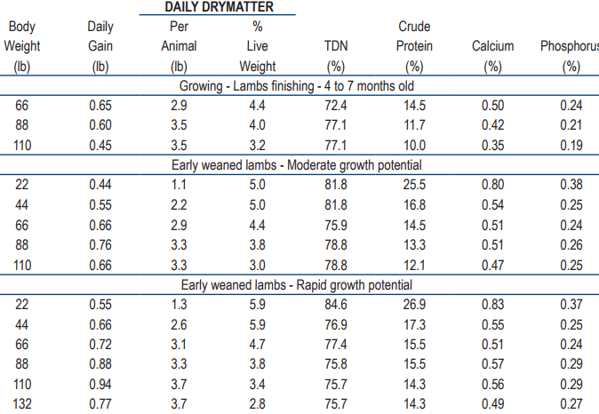
Nutrient Requirements of Lambs

Slide 52
Mineral Nutrition
Copper levels in mineral are important to know.
High Cu levels are toxic
Calcium:Phosphorus
2:1is optimum
Pasture can be low in Ca
Concentrates generally high in P
Urinary calculi
Limestone
Magnesium special consideration for nursing ewes
grass tetany
Selenium
White muscle disease
Inorganic vs organic
Goats need greater S conc.
Specific minerals mixes for Sheep and Goats

Slide 53
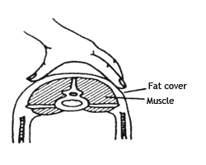
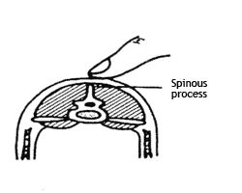
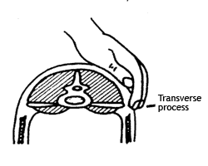
Body Condition Score
BCS 1(Emaciated) No fat between skin and bone. Ewes have no fat and very limited muscle energy reserves. Appear weak and unthrifty. Wool fleeces are often tender, frowsy and lack luster.
BCS 2(Thin) Only a slight amount of fatty tissue detectable between skin and bone. Spinous processes are relatively prominent. These ewes appear thrifty but have only minimal fat reserves.
BCS 3(Average) Average flesh but do not have excess fat reserves. This condition score includes ewes in average body condition.
BCS 4(Fat) Moderately fat. Moderate fat deposits give sheep a smooth external appearance.
BCS 5(Obese) Extremely fat. Excess fat deposits can easily be seen in the breast, flank, and tailhead regions. These ewes have excess fat reserves to the point that productivity may be impaired.

Slide 54
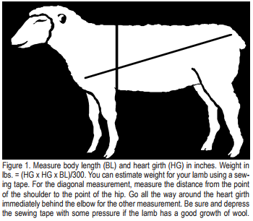
Estimating Sheep Bodyweight
https://extension.arizona.edu/sites/extension.arizona.edu/files/pubs/az1053.pdf

Slide 55
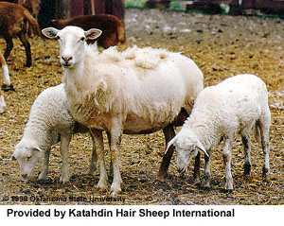
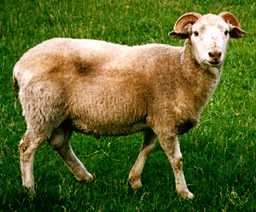
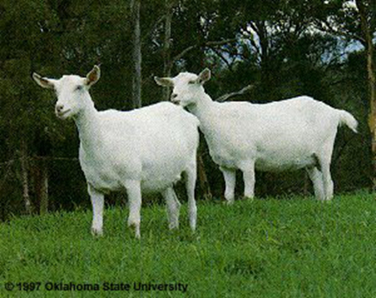
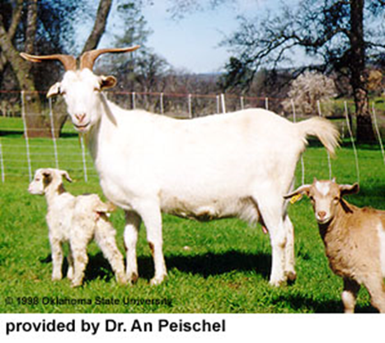
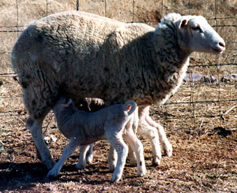
Questions

Slide 56
Beef Calf Show Feeding
Additional resource UF/IFAS EDIS document: Growing Calf and Show Steer Feed Management https://edis.ifas.ufl.edu/pdffiles/AN/AN25400.pdf

Slide 57
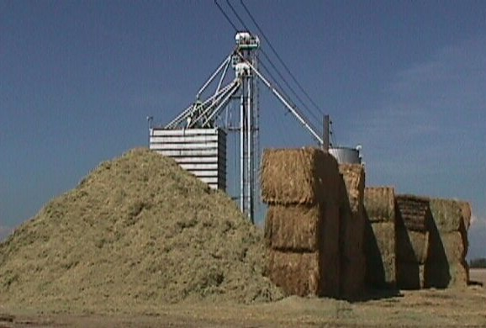
Roughage in Growing/Finishing Diets
Rumen function
Low dietary levels of roughage
digestive upsets: acidosis, liver abscesses
Small amounts: 3-15% roughage
~ 10% roughage will optimize performance
On an energy basis, roughage is one of the most expensive ingredients in the diet.
Roughage Sources
alfalfa hay, grass hay, silage, byproducts (hulls)

Slide 58
Nutritional Concerns
Feeding high concentrate diets upon arrival
increases energy intake
decreases cost of gain
improves performance
increases morbidity and mortality
Good quality hay (free choice) can help overcome the negative health aspects

Slide 59
Nutritional Concerns
What about adding fat to increase the energy intake?
Highly stressed calves (morbid) have low tolerance for fat
Improves performance of low-stressed calves
Stressed calves prefer a dry diet
Stressed calves have a low tolerance for urea and other NPN sources

Slide 60
Grains in Finishing Diets
Grain diets predispose the animal to acidosis
“Balancing Act”
max grain intake & minimize digestive disorders
cattle show gray off-color stools
indicative of acidosis
Grains that stimulate acidosis
wheat > corn ~ milo > barley
Greater risk with highly processed grains-fine grind

Slide 61
Table 1. Feeding system adaptation timeline
Timeline | Roughage-Hay | Grain-Concentrate, lbs | Predicted Total Intake, lbs
Arrival at home Day 0 to 3 | All calf will consume | 0 | 15
Adaptation
Day 3 | All calf will consume | 2 | 15
Day 5 to 6 | All calf will consume | 3 | 15
Day 7 to 8 | All calf will consume | 4 | 15
Day 9 to 10 | All calf will consume | 5 | 15
Day 11 to 12 | All calf will consume | 6 | 15
Day 13 to 14 | All calf will consume | 7 | 15
Growing-Finishing Step-up | Roughage-Hay, lbs (% of diet) | Grain-Concentrate, lbs (% of diet) | Predicted Total Intake, lbs
1 – 5 days | 7 (50%) | 7 (50%) | 14
2 – 5 days | 6 (40%) | 9 (60%) | 15
3 – 5 days | 5 (30%) | 11 (70%) | 16
4 – 5 days | 4 (20%) | 13 (80%) | 17
5 – remaining days | 20% | 80% | Increase daily feed amount
From UF/IFAS EDIS document Growing Calf and Show Steer Feed Management https://edis.ifas.ufl.edu/pdffiles/AN/AN25400.pdf

Slide 62
Table 2. Nutrient requirement of growing and finishing medium-frame beef calves¹
Body weight (lbs) | Average daily gain (lbs/day) | Dry matter intake (lbs) | TDN (%) | Protein (%) | TDN (lbs) | Protein (lbs) | Calcium (%) | Phosphorus (%)
500 | 0.5 | 11.6 | 54 | 8.4 | 6.3 | 0.97 | 0.25 | 0.17
 | 1.0 | 12.2 | 59 | 9.8 | 7.2 | 1.19 | 0.32 | 0.20
 | 1.5 | 12.6 | 61 | 11.2 | 8.1 | 1.41 | 0.40 | 0.22
 | 2.0 | 12.7 | 69 | 12.8 | 8.8 | 1.63 | 0.47 | 0.24
 | 2.5 | 12.5 | 75 | 14.7 | 9.4 | 1.84 | 0.56 | 0.27
 | 3.0 | 12.1 | 83 | 16.9 | 10.0 | 2.05 | 0.69 | 0.32
600 | 0.5 | 13.2 | 54 | 8.2 | 7.1 | 1.08 | 0.23 | 0.18
 | 1.0 | 14.0 | 59 | 9.4 | 8.3 | 1.31 | 0.28 | 0.19
 | 1.5 | 14.4 | 61 | 10.6 | 9.2 | 1.53 | 0.35 | 0.21
 | 2.0 | 14.6 | 69 | 11.9 | 10.1 | 1.74 | 0.40 | 0.22
 | 2.5 | 14.4 | 75 | 13.6 | 10.8 | 1.95 | 0.46 | 0.24
 | 3.0 | 13.8 | 83 | 15.7 | 11.5 | 2.17 | 0.57 | 0.29
700 | 0.5 | 14.9 | 54 | 8.0 | 8.0 | 1.19 | 0.22 | 0.18
 | 1.0 | 15.8 | 59 | 9.0 | 9.3 | 1.42 | 0.27 | 0.18
 | 1.5 | 16.2 | 61 | 10.1 | 10.4 | 1.64 | 0.31 | 0.20
 | 2.0 | 16.3 | 69 | 11.4 | 11.2 | 1.85 | 0.34 | 0.21
 | 2.5 | 16.1 | 75 | 12.8 | 12.1 | 2.06 | 0.40 | 0.22
 | 3.0 | 15.5 | 83 | 14.6 | 12.9 | 2.27 | 0.49 | 0.26
800 | 0.5 | 16.4 | 54 | 7.7 | 8.9 | 1.27 | 0.22 | 0.17
 | 1.0 | 17.5 | 59 | 8.3 | 10.3 | 1.44 | 0.24 | 0.19
 | 1.5 | 18.2 | 61 | 8.8 | 11.1 | 1.58 | 0.28 | 0.19
 | 2.0 | 18.6 | 69 | 9.2 | 12.8 | 1.72 | 0.31 | 0.20
 | 2.5 | 18.5 | 75 | 9.8 | 13.9 | 1.81 | 0.35 | 0.21
 | 3.0 | 16.8 | 83 | 10.8 | 13.9 | 1.81 | 0.42 | 0.25
900 | 0.5 | 17.9 | 54 | 7.6 | 9.7 | 1.36 | 0.21 | 0.18
 | 1.0 | 19.1 | 59 | 8.0 | 11.3 | 1.52 | 0.23 | 0.18
 | 1.5 | 19.9 | 61 | 8.4 | 12.1 | 1.66 | 0.25 | 0.19
 | 2.0 | 20.3 | 69 | 8.8 | 14.0 | 1.79 | 0.28 | 0.20
 | 2.5 | 20.2 | 75 | 9.3 | 15.2 | 1.84 | 0.31 | 0.20
 | 3.0 | 18.3 | 83 | 10.1 | 15.2 | 1.85 | 0.37 | 0.23
¹ Adapted from the 1996 Nutrient Requirements of Beef Cattle.

Slide 63
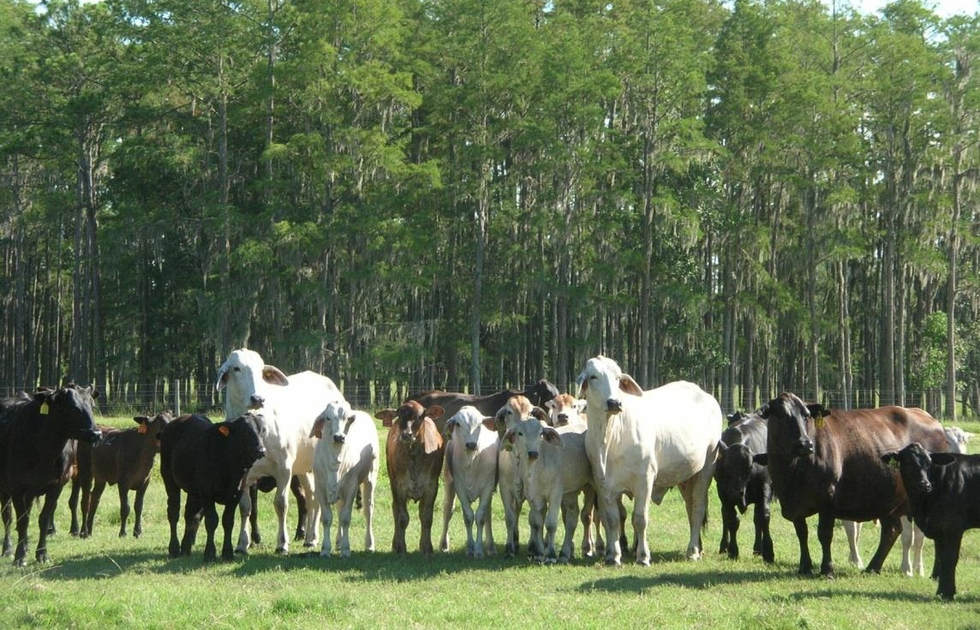
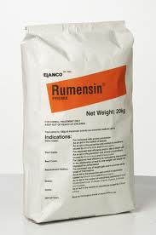
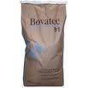
Ionophores
Monensin – Rumensin
Lasalocid – Bovatec
Laidlomycin proprionate – Cattlyst
Applications:
Backgrounding
Stocker
Replacement heifer development
Feedlot
Under utilized in Florida

Slide 64
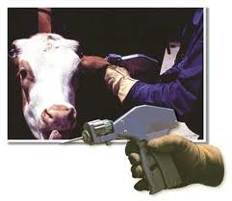
Implants
Growth promoting implants are pellets that are implanted under the skin of the ear of growing calves
Pellets release extremely low concentrations of various hormones
Improve growth rate, feed conversion, and protein deposition

Slide 65
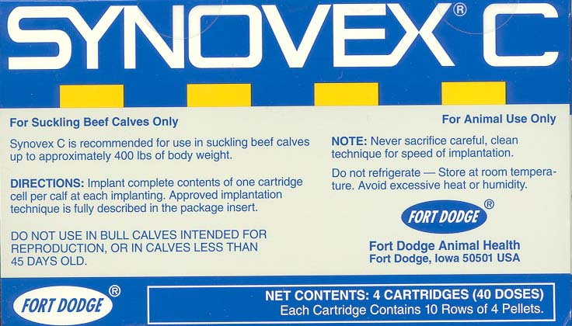
Implants
Promote growth by increasing lean tissue growth
Mild / less aggressive implants
Ralgro or Synovex C
Aggressive implants
Revelor-S or Component TE-S
Administered in ear
No withdraw time

Slide 66
Implants
Implant | Category | Relative Potency
Component E-C, Compudose, Encore, Implus-C, Synovex-C, Ralgro | Estrogen | Mild
Component E-S, Duralease, Implus-S, Synovex-S, Ralgro Magnum, | Estrogen | Strong
Component T-S, Component T-H, Finaplix-H, | Androgen
Component E-H, Component TE-G, Component TE-S Implus-H, Revalor-S, Revalor-H, Revelor-G, Revalor-IH, Revelor-IS, Synovex –H | Combination | Mild
Revalor-200, Synovex Plus | Combination | Strong
Montgomery, et al., 2001.

Slide 67
Calf Growth Rate for Show
2.47
3.02
3.57

Slide 68
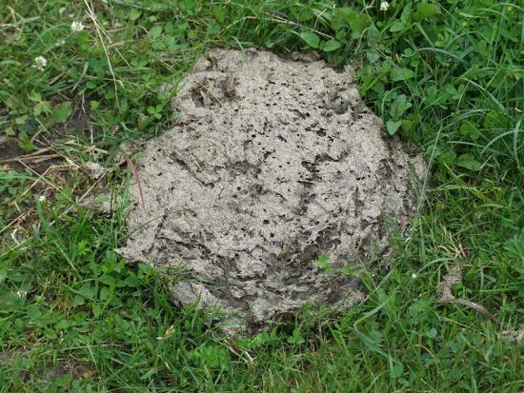
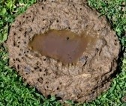
Nutritional Diseases
Acidosis – Laminitis - Founder
Too much feed / Too much energy / Too quickly
Not enough roughage / Not enough time
Loose, grey, watery stool
Refuse feed/water
Increase roughage
Decrease fed intake

Slide 69
Rumen Acidosis
Acute – life threatening
↑ liver abscesses, ↑ laminitis (founder)
Chronic – ↓ feed intake, performance
Managerial Control
Avoid drastic changes in diet
Feed ionophores (Rumensin)
Isocalorically replace grain with fat + roughage

Slide 70
Review
Energy = Average Daily Gain
Protein secondary
Feed enough: 2.5 to 3.0% of BW
No perfect feed
Include roughage (hay) in diet
Monitor Feed Intake and Gain

Slide 71
Questions
Remember you are growing FOOD!!

